Slide 1
Lecture 6 Part 1: Effect of image motion on image quality Part 2: Detectors and signal to noise ratio
Claire Max
Astro 289, UC Santa Cruz
January 28, 2020

Slide 2
Part One: Image motion and its effects on Strehl ratio
Sources of image motion:
Telescope shake due to wind buffeting (hard to model a priori – depends on telescope, dome, …)
Atmospheric turbulence
Image motion due to turbulence:
Sensitive to atm. inhomogenities > telescope diam. D
Hence reduced if “outer scale” of turbulence is ≤ D

Slide 3
Long exposures, no AO correction
“Seeing limited”: Units are radians
Seeing disk gets slightly smaller at longer wavelengths: FWHM ~ λ / λ^{-6/5} ~ λ^{-1/5}
For completely uncompensated images, wavefront error
σ²_{uncomp} = 1.02 ( D / r₀ )^{5/3}

Slide 4
Correcting tip-tilt has relatively large effect, for seeing-limited images
For completely uncompensated images
σ²_{uncomp} = 1.02 ( D / r₀ )^{5/3}
If image motion (tip-tilt) has been completely removed
σ²_{tiltcomp} = 0.134 ( D / r₀ )^{5/3}
(Tyson, Principles of AO, eqns 2.61 and 2.62)
Removing image motion can (in principle) improve the wavefront variance of an uncompensated image by a factor of 10
Origin of statement that “Tip-tilt is the single largest contributor to wavefront error”

Slide 5
But you have to be careful if you want to apply this statement to AO correction
If tip-tilt has been completely removed
σ²_{tiltcomp} = 0.134 ( D / r₀ )^{5/3}
But typical values of ( D / r₀ ) are 10 - 50 in the near-IR
Keck, D=10 m, r₀ = 60 cm at λ=2 μm, ( D/r₀ ) = 17
σ²_{tiltcomp} = 0.134 ( 17 )^{5/3} ~ 15
so wavefront phase variance is >> 1
Conclusion: if ( D/r₀ ) >> 1, removing tilt alone won’t give you anywhere near a diffraction limited image

Slide 6
Scaling of image motion due to turbulence
Mean squared deflection angle due to image motion: independent of λ and ∝ D^{-1/3}
But relative to Airy disk (diffraction limit), image motion gets worse for larger D and smaller wavelengths:

Slide 7
Typical values of image motion
Keck Telescope: D = 10 m, r₀ = 0.2 m, λ = 2 microns
So in theory at least, rms image motion is > 10 times larger than diffraction limit, for these numbers.

Slide 8
What maximum tilt angle must the tip-tilt mirror be able to correct?
For a Gaussian distribution, probability is 99.4% that the value will be within ± 2.5 standard deviations of the mean.
For this condition, the peak excursion of the angle of arrival is
Note that peak angle is independent of wavelength
2.5 σ
Notes:
Check on this

Slide 9
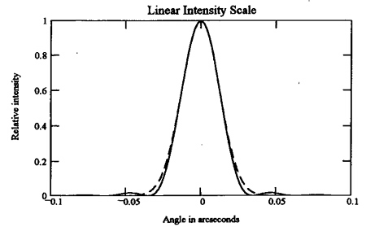
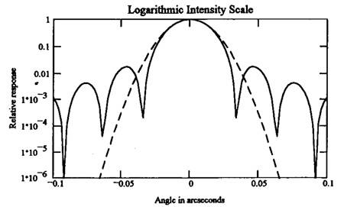
Use Gaussians to model the effects of image motion on image quality
Model the diffraction limited core as a Gaussian:
A Gaussian profile with standard deviation has same width as an Airy function

Slide 10
Tilt errors spread out the core
Effect of random tilt error σ_{α} is to spread each point of image into a Gaussian profile with standard deviation σ_{α}
If initial profile has width σ_{Α} then the profile with tilt has width σ_{Τ} = ( σ_{α}² + σ_{Α}² )^{1/2} (see next slide)

Slide 11
Image motion reduces peak intensity
Conserve flux:
Integral under a circular Gaussian profile with peak amplitude A₀ is equal to 2πA₀σ_{A}²
Image motion keeps total energy the same, but puts it in a new Gaussian with variance σ_{Τ}² = σ_{Α}² + σ_{α}²
Peak intensity is reduced by the ratio

Slide 12
Tilt effects on point spread function, continued
Since σ_{Α} = 0.44 λ / D, peak intensity of the previously diffraction-limited core is reduced by
Diameter of core is increased by F_{T}^{-1/2}
Similar calculations for the halo: replace D by r₀
Since D >> r₀ for cases of interest, effect on halo is modest but effect on core can be large
Notes:
Check on this

Slide 13
Typical values for Keck Telescope, if tip-tilt is not corrected
Core is strongly affected at a wavelength of 1 micron:
Core diameter is increased by factor of F_{T}^{-1/2} ~ 23
Halo is much less affected than core:
Halo peak intensity is only reduced by factor of 0.93
Halo diameter is only increased by factor of 1.04

Slide 14
Effects of turbulence depend on size of telescope
Coherence length of turbulence: r₀ (Fried’s parameter)
For telescope diameter D < (2 - 3) x r₀ :
Dominant effect is "image wander"
As D becomes >> r₀ :
Many small "speckles" develop
Computer simulations by Nick Kaiser: image of a star, r₀ = 40 cm
D = 1 m
D = 2 m
D = 8 m

Slide 15
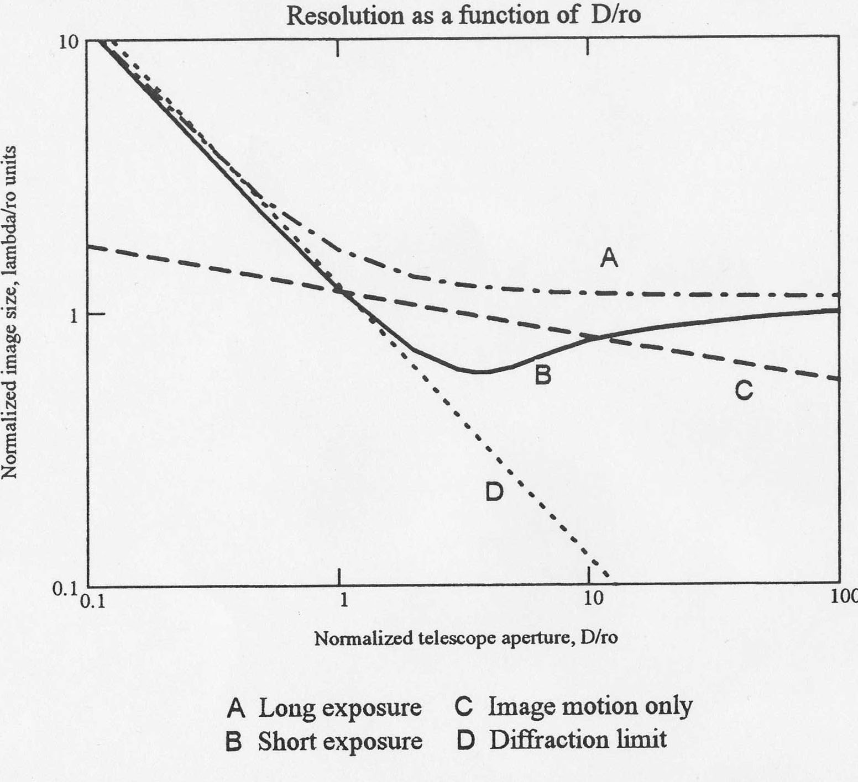
Effect of atmosphere on long and short exposure images of a star
Hardy p. 94
Vertical axis is image size in units of λ /r₀
Correcting tip-tilt only is optimum for D/r₀ ~ 1 - 3
Image motion only
FWHM = λ/D

Slide 16
Summary, Image Motion Effects (1)
Image motion
Broadens core of AO PSF
Contributes to Strehl degradation differently than high-order aberrations
Effect on Strehl ratio can be quite large: crucial to correct tip-tilt

Slide 17
Summary, Image Motion Effects (2)
Image motion can be large, if not compensated
Keck, λ = 1 micron, σ_{α} = 0.5 arc sec
Enters computation of overall Strehl ratio differently than higher order wavefront errors
Lowers peak intensity of core by F_{c}⁻¹ ~ 1 / 0.002 = 500 x
Halo is much less affected:
Peak intensity decreased by 0.93
Halo diameter increased by 1.04

Slide 18
How to correct for image motion
Natural guide star AO:
From wavefront sensor information, filter out all higher order modes, left with overall tip-tilt
Correct this tip-tilt with a “tip-tilt mirror”
Laser guide star AO:
Can use laser to correct for high-order aberrations but not for image motion (laser goes both up and down thru atmosphere, hence moves relative to stars)
So LGS AO needs to have a so-called “tip-tilt star” within roughly an arc min of target.
Can be faint: down to 18-19th magnitude will work

Slide 19
Implications of image motion for AO system design
Impact of image motion will be different, depending on the science you want to do
Example 1: Search for planets around nearby stars
You can use the star itself for tip-tilt info
Little negative impact of image motion smearing
Example 2: Studies of high-redshift galaxies
Sufficiently bright tip-tilt stars will be rare
Trade-off between fraction of sky where you can get adequate tip-tilt correction, and the amount of tolerable image-motion blurring
High sky coverage ➔ fainter tip-tilt stars farther away

Slide 20
Part 2: Detectors and signal to noise ratio
Detector technology
Basic detector concepts
Modern detectors: CCDs and IR arrays
Signal-to-Noise Ratio (SNR)
Introduction to noise sources
Expressions for signal-to-noise
Terminology is not standardized
Two Keys: 1) Write out what you’re measuring. 2) Be careful about units!
Work directly in photo-electrons where possible

Slide 21
References for detectors and signal to noise ratio
Excerpt from “Electronic imaging in astronomy”, Ian. S. McLean (1997 Wiley/Praxis)
Excerpt from “Astronomy Methods”, Hale Bradt (Cambridge University Press)

Slide 22
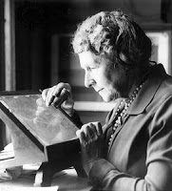
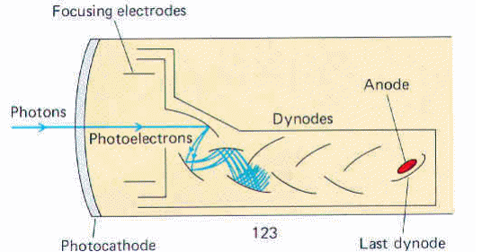
Early detectors: photographic plates, photomultipliers
Photographic plates
very low Quantum Efficiency: QE ~ 1 - 4%
non-linear response
very large areas, very small “pixels” (grains of silver compounds)
hard to digitize
Photomultiplier tubes
low QE (10%)
no noise: each photon produces cascade
linear at low signal rates
easily coupled to digital outputs

Slide 23
Modern detectors are based on semiconductors
In semiconductors and insulators, electrons are confined to a number of specific bands of energy
“Band gap" = energy difference between top of valence band and bottom of the conduction band
For an electron to jump from a valence band to a conduction band, need a minimum amount of energy
This energy can be provided by a photon, or by thermal energy, or by a cosmic ray
Vacancies or holes left in valence band allow it to contribute to electrical conductivity as well
Once in conduction band, electron can move freely and be collected

Slide 24
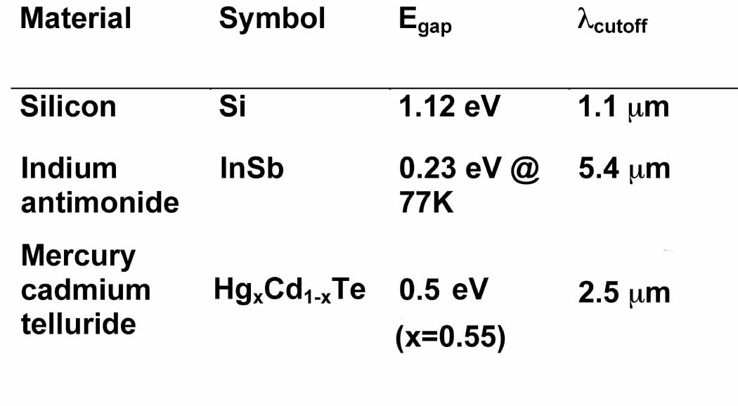
Bandgap energies for commonly used detectors
If the forbidden energy gap is E_{G} there is a cut-off wavelength beyond which the photon energy (hc/λ) is too small to cause an electron to jump from the valence band to the conduction band
Credit: Ian McLean

Slide 25
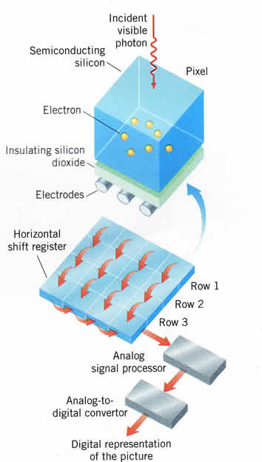
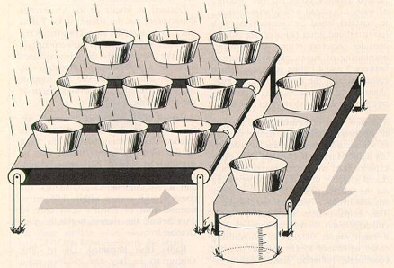
CCD transfers charge from one pixel to the next in order to make a 2D image
rain
conveyor belts
bucket
By applying “clock voltage” to pixels in sequence, can move charge to an amplifier and then off the chip

Slide 26
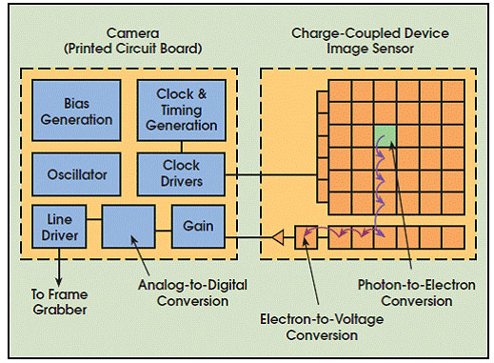
Schematic of CCD and its read-out electronics
“Read-out noise” injected at the on-chip electron-to-voltage conversion (an on-chip amplifier)

Slide 27
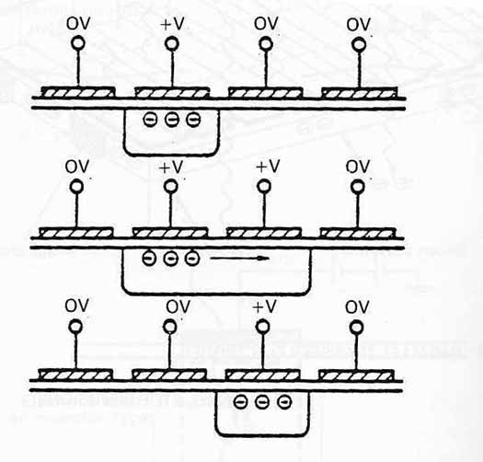
CCD readout process: charge transfer
Adjusting voltages on electrodes connects wells and allow charge to move
Charge shuffles up columns of the CCD and then is read out along the top
Charge on output amplifier (capacitor) produces voltage
Video animation:
https://www.youtube.com/watch?v=PoXinWleWns

Slide 28
Modern detectors: photons ➜ electrons ➜ voltage ➜ digital numbers
With what efficiency do photons produce electrons?
With what efficiency are electrons (voltages) measured?
Digitization: how are electrons (analog) converted into digital numbers?
Overall: What is the conversion between photons hitting the detector and digital numbers read into your computer?

Slide 29
Primary properties of detectors
Quantum Efficiency QE: Probability of detecting a single photon incident on the detector
Spectral range (QE as a function of wavelength)
“Dark Current”: Detector signal in the absence of light
“Read noise”: Random variations in output signal when you read out a detector
Gain g : Conversion factor between internal voltages and computer “Data Numbers” DNs or “Analog-to-Digital Units” ADUs

Slide 30
Secondary detector characteristics
Pixel size (e.g. in microns)
Total detector size (e.g. 1024 x 1024 pixels)
Readout rate (in either frames per sec or pixels per sec)
Well depth (the maximum number of photons or photoelectrons that a pixel can record without “saturating” or going nonlinear)
Cosmetic quality: Uniformity of response across pixels, dead pixels
Stability: does the pixel response vary with time?

Slide 31
CCDs are the most common detector for wavefront sensors
Can be read out fast (e.g., every few milliseconds so as to keep up with atmospheric turbulence)
Relatively low read-noise (a few to 10 electrons)
Only need modest size (e.g., largest today is only 256x256 pixels)

Slide 32
CCD phase space
CCDs dominate inside and outside astronomy
Even used for x-rays
Large formats available (4096x4096) or mosaics of smaller devices. Gigapixel focal planes exist.
High quantum efficiency 80%+
Dark current from thermal processes
Long-exposure astronomy CCDs are cooled to reduce dark current
Readout noise can be several electrons per pixel each time a CCD is read out
Trade high readout speed vs added noise
To reduce read noise, usually have to reduce speed

Slide 33
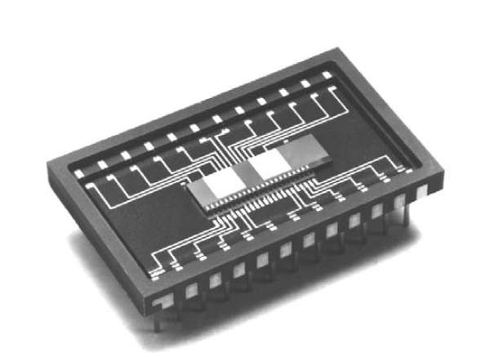
What do CCDs look like?
Carnegie 4096x4096 CCD Subaru SuprimeCam Mosaic
Slow readout (science) Slow readout (science)
E2V 80 x 80
fast readout for
wavefront sensing

Slide 34
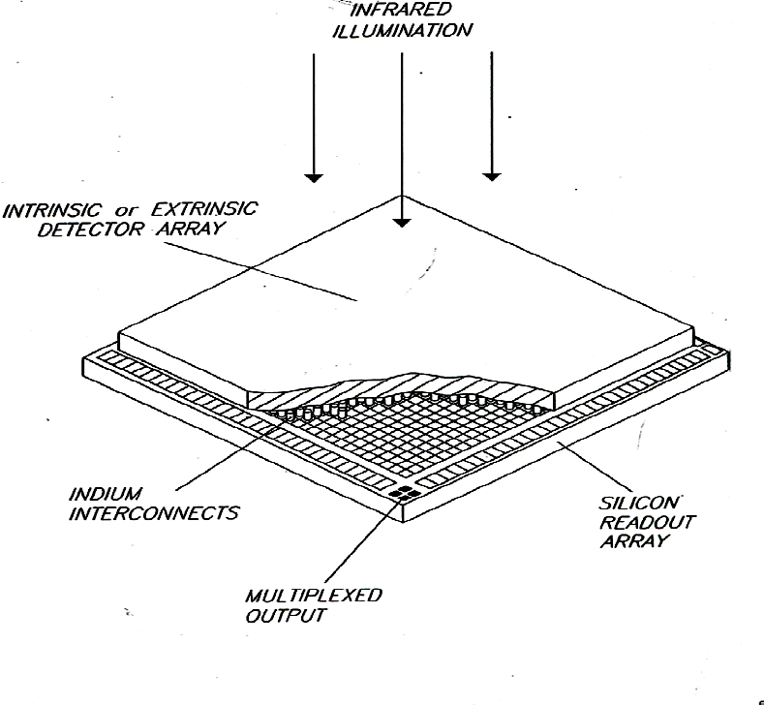
Infrared detectors (e.g. Hawaii 2RG)
Read out pixels individually, by bonding a multiplexed readout array to the back of the photo-sensitive material
Photosensitive material must have lower band-gap than silicon, in order to respond to lower-energy IR photons
Materials: InSb, HgCdTe, ...

Slide 35
Credit: Gert Finger

Slide 36
Recent development: IR Avalanche Photodiode Arrays -- Saphira
Until now we have not had high frame rate, low noise infrared detector arrays, so it was not feasible to do high-order wavefront sensing at near-infrared wavelengths.
Selex Avalanche Photodiode for HgCdTe InfraRed Array (SAPHIRA) detector is the first technology that enables this
SAPHIRA detectors are HgCdTe linear avalanche photodiode arrays
320×256 pixels (enough for wavefront sensing at least on 8-10m telescopes)
Sensitive to 0.8-2.5 µm light.
Key features:
Fast readout rates while maintaining low readout noise
Low dark current
Ability to read out subarrays without a noise penalty
Ideal for infra-red wavefront sensing

Slide 37
Types of noise in instruments
Every instrument has its own characteristic background noise
Example: cosmic ray particles passing thru a CCD knock electrons into the conduction band
Some residual instrument noise is statistical in nature; can be measured very well given enough integration time
Some residual instrument noise is systematic in nature: cannot easily be eliminated by better measurement
Example: difference in optical path to wavefront sensor and to science camera
Typically has to be removed via calibration

Slide 38
Statistical fluctuations = “noise”
Definition of variance:
where m is the mean, n is the number of independent measurements of x, and the x_{i} are the individual measured values
If x and y are two random independent variables, the variance of the sum (or difference) is the sum of the variances:

Slide 39
Main sources of detector noise for wavefront sensors in common use
Poisson noise or photon statistics
Noise due to statistics of the detected photons themselves
Read-noise
Electronic noise (from amplifiers) each time CCD is read out
Other noise sources (less important for wavefront sensors, but important for other imaging applications)
Sky background
Dark current

Slide 40
Photon statistics: Poisson distribution
CCDs are sensitive enough that they care about individual photons
Light is quantum in nature. There is a natural variability in how many photons will arrive in a specific time interval T , even when the average flux F (photons/sec) is fixed.
We can’t assume that in a given pixel, for two consecutive observations of length T, the same number of photons will be counted.
The probability distribution for N photons to be counted in an observation time T is

Slide 41
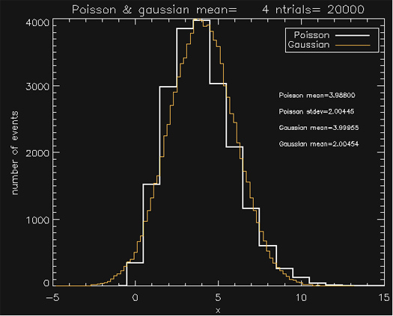
Properties of Poisson distribution
Average value = FT
Standard deviation = (FT)^{1/2}
Approaches a Gaussian distribution as N becomes large
Horizontal axis: FT
Credit: Bruce Macintosh

Slide 42
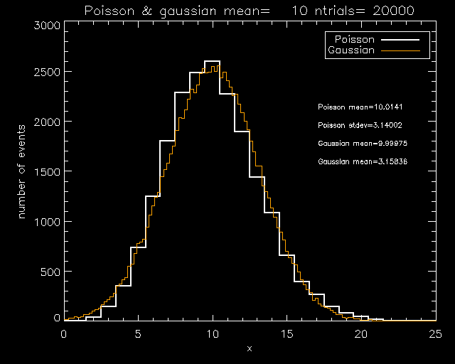
Properties of Poisson distribution
Horizontal axis: FT
Credit: Bruce Macintosh

Slide 43
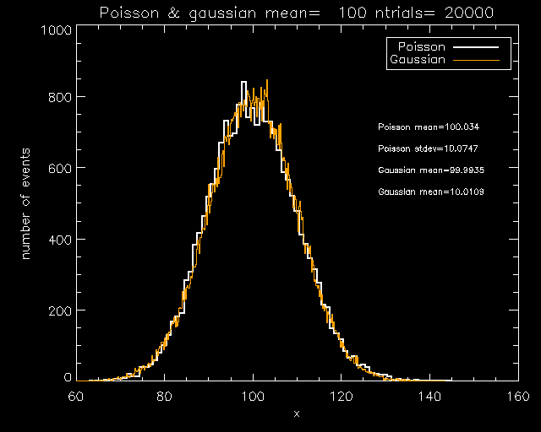
Properties of Poisson distribution
When < FT > is large, Poisson distribution approaches Gaussian
Standard deviations of independent Poisson and Gaussian processes can be added in quadrature
Horizontal axis: FT
Credit: Bruce Macintosh

Slide 44
How to convert between incident photons and recorded digital numbers ?
Digital numbers outputted from a CCD are called Data Numbers (DN) or Analog-Digital Units (ADUs)
Have to turn DN or ADUs back into microvolts, electrons, photons to have a calibrated system
where QE is the quantum efficiency (what fraction of incident photons get made into electrons), g is the photon transfer gain factor (electrons/DN) and b is an electrical offset signal or bias

Slide 45
To calculate SNR, look at all the various noise sources
Wisest to calculate SNR in electrons rather than ADU or magnitudes
Noise comes from Poisson noise in the object, Gaussian-like readout noise RN per pixel, Poisson noise in the sky background, and dark current noise D
Readout noise:
where n_{pix} is the number of pixels and RN is the readout noise
Photon noise:
Sky background: for B_{Sky} e⁻/pix/sec from the sky,
Dark current noise: for dark current D (e⁻/pix/sec)

Slide 46
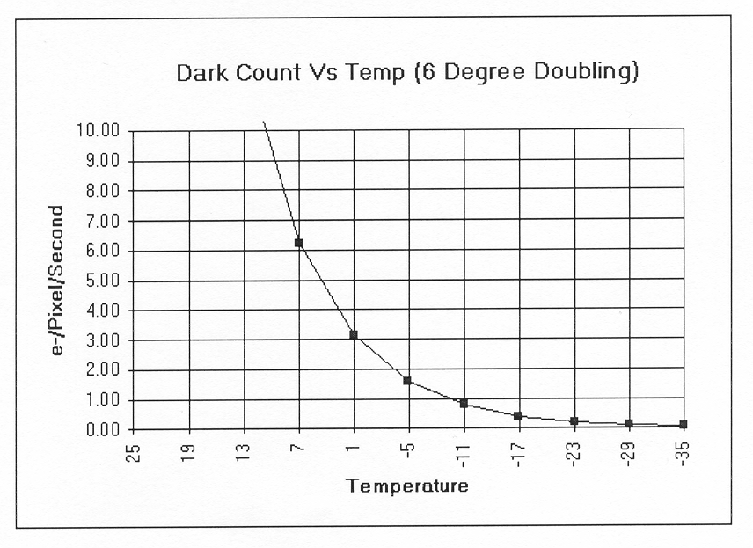
Dark Current or Thermal Noise: Electrons reach conduction bands due to thermal excitation
Science CCDs are always cooled (liquid nitrogen, dewar, etc.)
Credit: Jeff Thrush

Slide 47
Total signal to noise ratio – important!
where F is the average photo-electron flux, T is the time interval of the measurement, B_{Sky} is the electrons per pixel per sec from the sky background, D is the electrons per pixel per sec due to dark current, and RN is the readout noise per pixel.

Slide 48
Some special cases
Poisson statistics: If detector has very low read noise, sky background is low, dark current is low, SNR is
Read-noise dominated: If there are lots of photons but read noise is high, SNR is
If you add multiple images, SNR ~ ( N_{images} )^{1/2}

Slide 49
Typical noise cases for astronomical AO
Wavefront sensors
Read-noise dominated:
Imagers (cameras)
Sky background limited:
Spectrographs
Either sky background or dark current limited:

